Slide 1
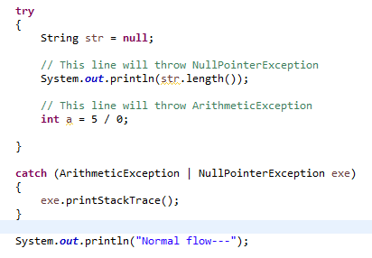
Catching More Than One Type of Exception with One Exception Handler
In Java SE 7 and later, a single catch block can handle more than one type of exception. This feature can reduce code duplication and lessen the temptation to catch an overly broad exception.
In the catch clause, specify the types of exceptions that block can handle, and separate each exception type with a vertical bar (|)
If a catch block handles more than one exception type, then the catch parameter is implicitly final. In this example, the catch parameter exe is final and therefore you cannot assign any values to it within the catch block.

